Slide 1

Ethics and Professional Values in the Digital Workplace
WEEK 2

Slide 2
Lesson outlines
Understanding the Digital Economy
Professionalism in the Digital Workplace
Ethical Considerations in Digital Practices
Application of Ethical Theories
Professional Values in Digital Practices
Notes:
1. Understanding the Digital Economy
Students will be able to define the Digital Economy and explain its fundamental shift from traditional industrial economies to knowledge-based economies.
Students will describe how intellectual capital, technology, and networked intelligence contribute to value creation in the digital economy.
Students will analyze the impact of globalization and the development of new business models in the digital economy.
2. Professionalism in the Digital Workplace
Students will understand the key elements of professionalism as described by Freidson's Professionalism Theory, including the monopoly of knowledge and the role of professional institutions.
Students will explain how professionalism shapes labor markets and creates a unique category of labor.
Students will recognize the role of professional autonomy, certification processes, and accountability mechanisms in maintaining ethical practices in the workplace.
3. Ethical Considerations in Digital Practices
Students will identify key ethical considerations for professionals in digital fields, including privacy, data protection, cybersecurity, and digital inclusion.
Students will understand the importance of professional competence and integrity in ensuring fair, responsible, and socially beneficial technological practices.
Students will explore the societal impacts of digital technologies and the responsibility of digital practitioners to ensure technology serves the public good without perpetuating harm or bias.
4. Application of Ethical Theories
Students will apply key ethical theories such as Deontological Ethics (Kant) and Utilitarianism (Bentham & Mill) to real-world digital practice scenarios.
Students will engage in critical discussions about ethical dilemmas and propose solutions using these frameworks.
5. Professional Values in Digital Practices
Students will define and apply the core professional values expected in the digital workplace, including integrity, confidentiality, competence, responsibility, and respect for others.
Students will understand the significance of commitment to public good in professional practices and apply this in evaluating technological impacts.

Slide 3

What is an Economy?

Slide 4
Digital Economy Theory (Tapscott, 1996)
The Digital Economy Theory by Don Tapscott, introduced in his 1996 book "The Digital Economy: Promise and Peril in the Age of Networked Intelligence", explores how digital technologies, particularly the internet, have fundamentally transformed economies, businesses, and society. Tapscott highlighted the transition from traditional industrial economies to a knowledge-based digital economy.
Key points of his theory include:

Slide 5
Transformation of Value Creation (Tapscott theory)
In the digital economy, value is created not from physical assets but from:
intellectual capital (e.g., secret formula of Coca-Cola soft drink )
Information
technology

Slide 6

Networked Intelligence (Tapscott theory)
Technology enables:
decentralized market + virtual market (e.g., Forex, Real Estate…)
networked collaboration (even if they are geographically separated)
Image: https://pixabay.com/ru/illustrations/%D0%BC%D1%8F%D1%87-%D0%BA%D1%80%D1%83%D0%B3%D0%BB%D1%8B%D0%B9-%D0%B3%D0%BB%D0%BE%D0%B1%D1%83%D1%81-%D0%BC%D0%B8%D1%80-%D0%B7%D0%B5%D0%BC%D0%BB%D1%8F-%D0%BF%D1%83%D0%BB%D1%8F-275711/
Notes:
fostering innovation and disrupting traditional hierarchies in organizations.

Slide 7

Globalization (Tapscott theory)
The internet dissolves geographical barriers, allowing businesses and individuals to operate on a global scale with fewer limitations

Slide 8
New Business Models (Tapscott theory)
Digital technologies gave rise to new business models such as:
e-commerce
digital marketplaces
peer-to-peer networks
challenging conventional approaches (training product development)
Notes:
*Peer-to-peer computing or networking is a distributed application architecture that partitions tasks or workloads between peers.

Slide 9
Empowerment of Consumers (Tapscott theory)
With access to information and digital tools, consumers became more empowered, influencing:
product design
customer service
business strategies

Slide 10
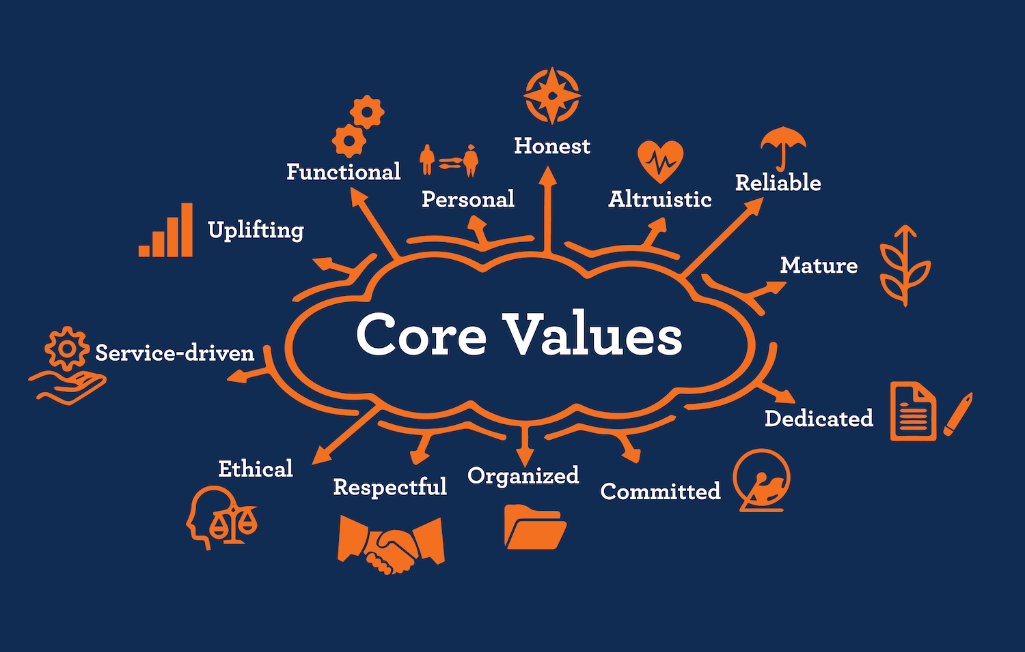
Professionalism

Slide 11
Professionalism Theory (Freidson, 2001)
In his seminal work "Professionalism: The Third Logic", Eliot Freidson (2001) explores the concept of professionalism as a distinct organizing principle in modern societies. Freidson's Professionalism Theory investigates how certain occupations, such as medicine, law, and engineering, develop social structures and norms that define what it means to be a professional, distinguishing them from other forms of work.
Key points of the theory include:

Slide 12
The Third Logic (Freidson theory)
Freidson argues that professionalism constitutes a third logic of control, distinct from the market and bureaucratic logics. Unlike markets driven by consumer choice and bureaucracies governed by formal rules, professionalism operates on specialized knowledge and autonomy in regulating work.

Slide 13
Monopoly of Knowledge (Freidson theory)
Professionals maintain exclusive control over certain areas of expertise, often regulated by licensing and certification.
This monopoly over specialized knowledge gives professionals significant power within labor markets and society.

Slide 14
Social Structures of Professions (Freidson theory)
Professions are supported by institutions (such as professional associations) that define:
These structures ensure that professionals maintain authority and autonomy over their work.
ethical guidelines
certification processes
the standards of practice (policy statements)
Notes:
*ethical codes- what actions are morally right and wrong.
*certification processes- a systematic procedure for evaluating, describing, testing, and authorizing systems or activities

Slide 15
Impact on Labor Markets (Freidson theory)
Professionalism shapes labor markets by determining who can enter certain fields, the requirements for training and education, and the regulation of practice.
This creates a unique category of labor that is resistant to commodification and standardization.

Slide 16
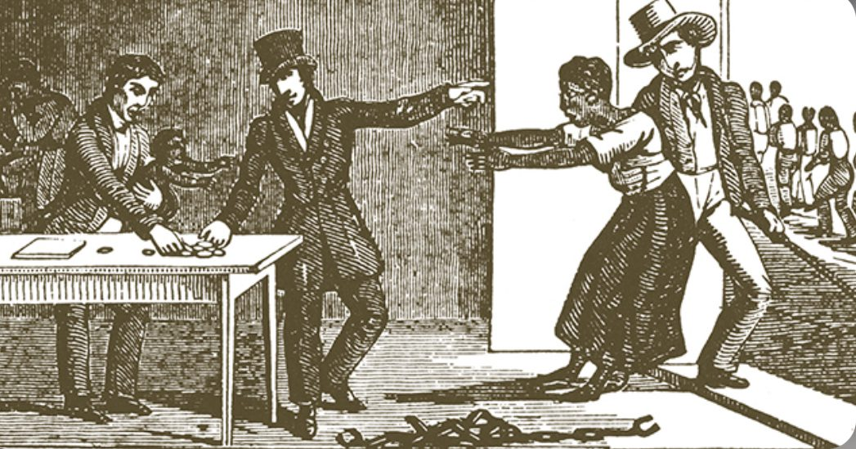

Commodification VS Job Fairness
Image source:
https://www.buschvacuum.com/ee/en/news-media/fairness-on-the-job-at-busch.html
https://www.upendmovement.org/2023/02/16/no-coincidence

Slide 17
Professional Autonomy (Freidson theory)
Professionals often have the autonomy to:
self-regulate
determining their working conditions
standards of practice (who can do what activity)
*accountability mechanisms
-systems that hold people or entities responsible for their actions
This autonomy is one of the defining features that separates professional work from other forms of labor.

Slide 18
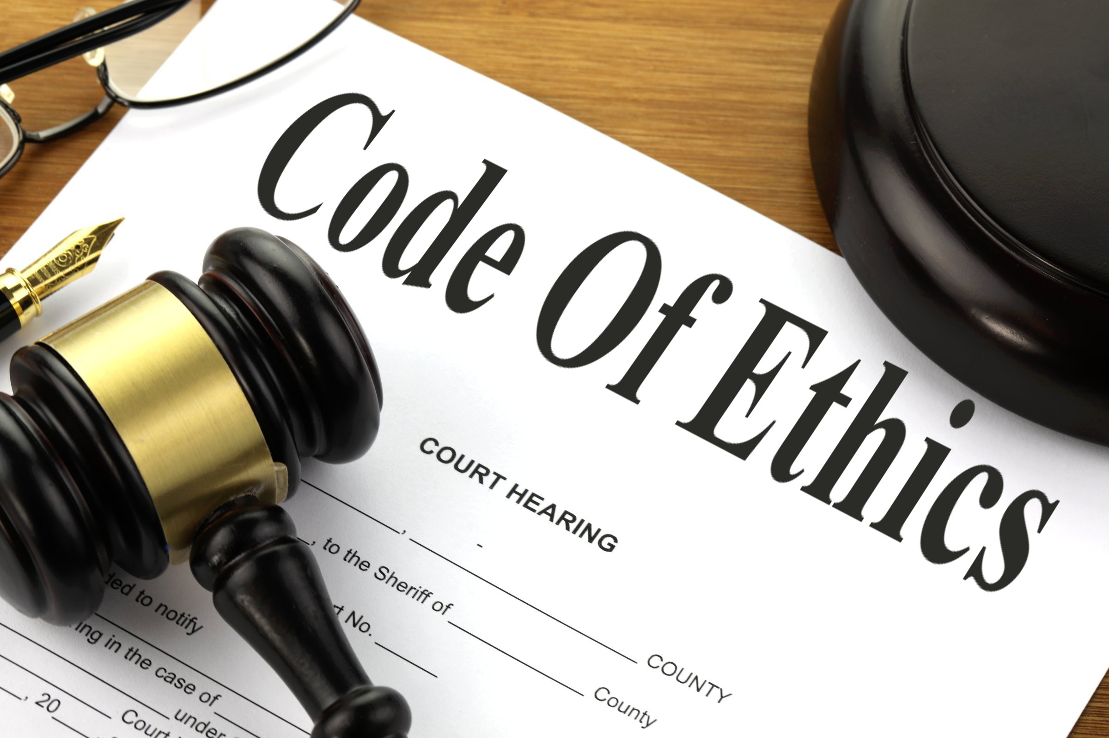
Ethical Considerations in Digital Practices and Professional Values Expected of Practitioners

Slide 19
Code of Ethics
In the digital age, ethical considerations have become critical as technology and digital practices increasingly impact society. Professionals in the field of technology and digital services are expected to uphold certain ethical standards and values to ensure their work benefits society and minimizes harm.
Key ethical considerations include:

Slide 20
Privacy and Data Protection
Practitioners are expected to protect the personal and sensitive data of individuals and organizations. This involves:
data protection laws (such as GDPR)
ensuring transparency in how data is collected, stored, and used.
*Misuse of data can lead to privacy violations, identity theft, and loss of trust in digital systems.

Slide 21

GDPR - EU general data protection regulation
the strongest privacy and security law in the world
Image: https://bestwebsiteaccessibility.com/gdpr-complete-overview-general-data-protection-regulation/

Slide 22
Cybersecurity
Protecting digital infrastructure from cyber threats, including hacking, malware, and unauthorized access, is a key responsibility of digital practitioners.
Ethical practices involve proactive measures to secure systems and ensure the safety of users' data and digital interactions.

Slide 23
Digital Inclusion
Ethical digital practices advocate for bridging the digital divide and ensuring that technology is ACCESSIBLE to all segments of society, regardless of socioeconomic status, geographic location, or disabilities.
This includes designing user-friendly and inclusive technologies.
Notes:
Axloqiy raqamli amaliyotlar raqamli tafovutni bartaraf etish va texnologiyaning ijtimoiy-iqtisodiy holati, geografik joylashuvi yoki nogironligidan qat'i nazar, jamiyatning barcha qatlamlari uchun ochiq bo'lishini ta'minlashga yordam beradi. Bu foydalanuvchilarga qulay va inklyuziv texnologiyalarni loyihalashni o'z ichiga oladi.

Slide 24
Professional Competence and Integrity
High standards of professional competence:
continually updating knowledge and skills
Integrity – no lying and/or manipulating users

Slide 25

Social Responsibility
Digital practitioners have a broader responsibility to consider the societal impact of their work. This includes ensuring that the technologies they develop are used for good and do not perpetuate harm, discrimination, or bias.
For example, AI systems must be designed and
monitored to avoid reinforcing prejudiced outcomes.

Slide 26
Professional Values Expected of Practitioners
Integrity
Confidentiality
Competence
Responsibility
Respect for Others
Commitment to Public Good

Slide 27
Homework (Review the following theories)
Deontological Ethics (Kant, 1785): A duty-based ethical approach that examines the rightness or wrongness of actions regardless of consequences.
Utilitarianism (Bentham & Mill, 1789): Focuses on the outcomes, suggesting that the best ethical action is the one that maximizes overall "happiness."

Slide 28
REFERENCE LIST and ADDITIONAL READING
Floridi, L. (2013). The Ethics of Information. Oxford University
Press.Tavani, H. T. (2011). Ethics and Technology: Controversies, Questions, and Strategies for Ethical Computing. Wiley.
Freidson, E. (2001). Professionalism: The Third Logic. Polity Press.
Tapscott, D. (1996). The Digital Economy: Promise and Peril in the Age of Networked Intelligence. McGraw-Hill.

Slide 29
THANK YOU!

